Slide 1

Generation Z
Project Completion Report: Understand Career aspiration of GenZ....!!
Born between 1997 and 2012
Presented By Prashant Singh

Slide 2

Introduction
This project focuses on understanding the career aspirations of Generation Z, who often face challenges in pursuing desired roles, with their goals overlooked by employers. At the same time, employers struggle to attract, retain, and manage Gen Z talent. Using prescriptive and descriptive analytics, the project aims to provide insights and recommendations to both freshers and employers, helping to address these challenges and improve alignment between Gen Z's career goals and workplace opportunities.

Slide 3

Problem Statement
The problem lies in the disconnect between Generation Z's career aspirations and the expectations of employers. Gen Z often struggles to have their career goals recognized, while employers face difficulties in attracting, retaining, and managing this new generation of workers. This misalignment creates challenges on both sides, impacting job satisfaction, employee retention, and talent management.

Slide 4

Project Objectives
1. Understand the career aspirations of Gen Z.
2. Identify gaps between Gen Z’s expectations and employer offerings.
3. Provide strategies for employers to attract and retain Gen Z talent.
4. Empower Gen Z to achieve their career goals.
5. Use analytics to offer actionable insights for both Gen Z and employers.

Slide 5

Stakeholder Identification for GenZ
1. HR Managers
2. Gen Z Individuals
3. Educational Institutions
4. Career Counselors
5. Company Executives
6. Industry Experts/Consultants.

Slide 6

Project Planning:
Data Collection
2. Data Cleaning
3. Data Analysis (Excel)
4. SQL Data Analysis
5. Dashboard Creation

Slide 7

Data Collection
The first step involves creating a 30-question survey designed to capture the career aspirations, challenges, and expectations of Generation Z. This survey will be shared on social media platforms such as LinkedIn to reach a broad audience of Gen Z respondents. The questions should be carefully crafted to gather both quantitative and qualitative data, covering aspects like preferred industries, desired work environments, and challenges faced in achieving career goals. Once shared, responses will be collected over a set period to ensure a diverse and representative sample for further analysis. The survey link, like this Google Form, will allow easy data submission and retrieval for the next steps in the project.

Slide 8

2. Data Cleaning (Excel)
Once the survey data is collected, the next step is to clean the dataset in Excel to ensure accuracy and consistency. This involves standardizing all column headers to maintain uniformity across the dataset. Each row (representing a respondent's answer) will also be standardized to ensure consistent formatting. Any null or missing cells will be filled appropriately—numeric fields with "0" and text fields with "N/A" or a relevant placeholder. It's important not to delete any columns or data, as all information is valuable for analysis. The cleaned data will be structured in rows for clarity, ready for further analysis. The final cleaned dataset will be submitted in Excel format.

Slide 9
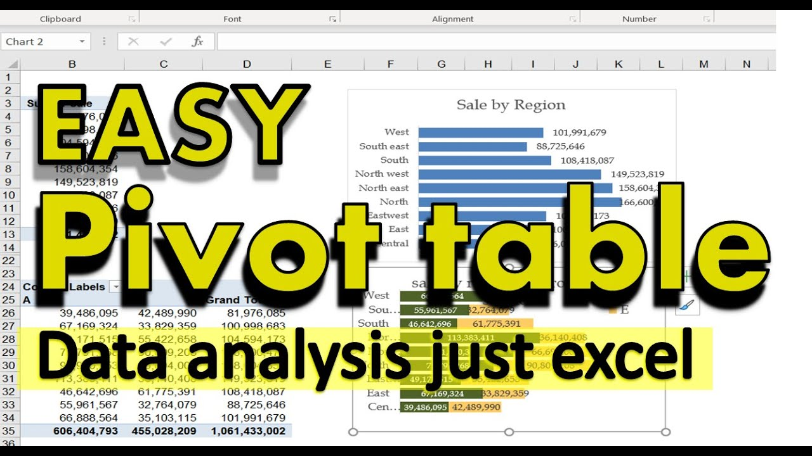
3. Data Analysis(Excel)
After cleaning the data, the next step is to analyze it using Excel, specifically by utilizing pivot tables. Pivot tables will allow us to organize and summarize the data efficiently, helping to identify key patterns and insights. For instance, we can filter the data by location, focusing specifically on responses from India to avoid skewed results from other regions. By analyzing each survey question, we can generate meaningful insights, providing a two-line summary for each to highlight the key findings. This approach helps in understanding the preferences, challenges, and career aspirations of Gen Z respondents. The analysis will be documented and submitted in Excel format for easy review and stakeholder presentation.

Slide 10

4. SQL Data Analysis
After the Excel analysis, the dataset will be imported into a SQL database for deeper analysis. SQL queries will be used to filter, group, and analyze the data, allowing for more advanced insights and efficient data handling. Using SQL, we can perform operations like filtering by specific demographics (e.g., focusing on Indian respondents), grouping data by industry preferences, and calculating averages or other statistics. This approach allows for complex querying to extract business answers and trends from the data, such as identifying the most preferred career paths among Gen Z or understanding common challenges they face. The results will help to complement the Excel analysis and provide a more comprehensive view of the data.

Slide 11
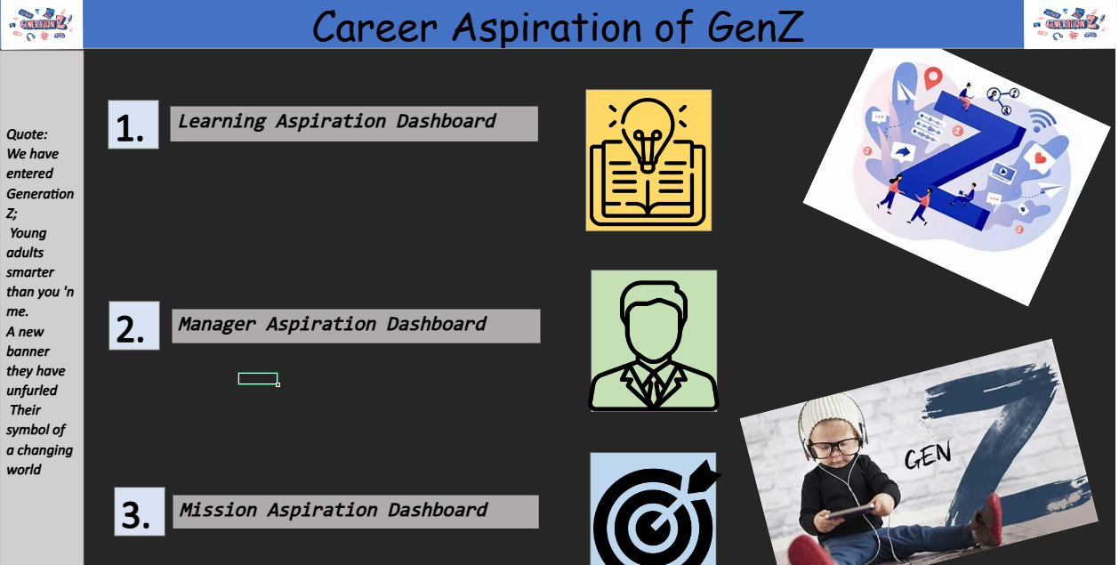
5. Dashboard Creations
After data analysis, we have created three key dashboards in Excel to visualize important insights:
1. Learning Aspirations Dashboard: Focuses on career influences, education abroad, sponsorship needs, and willingness to work for three years. Key columns include *Career Aspiration Influence*, *Education Abroad*, and *Sponsorship Needs*.
2. Manager Aspirations Dashboard: Analyzes preferences for working conditions such as abusive managers, remote work, daily hours, and salary expectations. Columns include *Abusive Manager*, *Remote Work*, *Work Hours*, and *Salary Expectations*.
3. Mission Aspirations Dashboard: Evaluates company mission clarity, alignment, and interest in socially impactful companies. Columns include *Mission Clarity*, *Mission Alignment*, and *Social Impact*.
These dashboards will help visualize insights for easy interpretation and decision-making.
Dashboard Github Link : Click Here

Slide 12

Highlighting Five "WOW" Insights which is significant, surprising, or impactful. And, I discovered during the project. They are as follows :

Slide 13

Insight1 :
In Learning Aspiration Dashboard, I discover 22% of GenZ individuals need sponsorship.
And 69% interested in going to study abroad.
GenZ most influence by Parents.
Most of the GenZ don't want to work for misaligned mission company.
GenZ seem least interested in working for 3 yrs same company but if we offer good enviornment and hikes. It may think to hold jobs for longer time.
Most of GenZ choose remote job option to maintain work-life balance.

Slide 14

Insight2 :
In Manager's Aspiration dashboard, we find 33% of GenZ want remote job offer.
We find 95% of don’t want to work with abusive managers.
GenZ willingness to work for 8 hrs a day.
Their minimum salary was >50K for first three years.
After 5 years, they want min salary of >151k.

Slide 15

Insight3 :
In Mission Aspiration Dashboard, we fond 67% of Genz want to work defined mission companies.
And 72% of GenZ want to work with mission aligned companies.
They ready to work with the company who recently layoff because they know the genuine reason behind this.
GenZ prefer self-paced learning.
Most of the Genz want on-site work also.

Slide 16

Insight4 :
GenZ seeks a workplace that aligns with their values, offering flexibility, support, and growth opportunities. They value mission-driven companies, with 72% wanting alignment with company goals and 67% preferring clearly defined missions. Parental influence is significant, and while they tend to avoid long-term commitments to one company, a positive environment with good incentives may increase retention. Remote work is highly valued for work-life balance, though some are open to on-site roles. Salary expectations are high, with a minimum of >50K for the first three years and >151K after five years. GenZ prioritizes self-paced learning, appreciates transparency, and is willing to work for companies that have undergone layoffs if reasons are genuine. An ideal workplace must cater to these needs, combining flexibility, career progression, and mission alignment to attract and retain this driven generation.

Slide 17
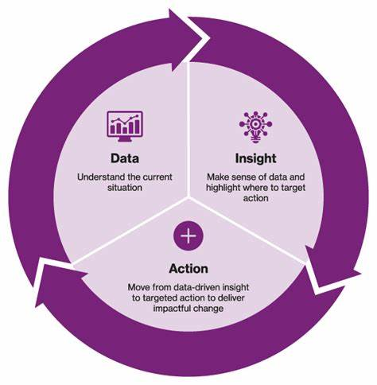
Insight5 :
To attract and retain GenZ talent, companies should focus on offering flexible work options, including remote opportunities, and ensure their mission aligns with GenZ values. A supportive, positive work environment free from toxic management is crucial. Clear career progression and competitive salaries, starting at >50K and rising to >151K after five years, will meet their financial expectations. Providing opportunities for self-paced learning and demonstrating transparency during difficult times, such as layoffs, will also foster trust and loyalty.
"Recommendation"

Slide 18

Lessons Learned
Throughout this project, several key lessons emerged. First, targeted data collection is crucial for gathering meaningful insights, especially when reaching out to a specific demographic like Generation Z. Second, data cleaning is a critical step that ensures accuracy and consistency, preventing errors in analysis. Third, using tools like Excel and SQL for data analysis helps uncover trends and patterns that would otherwise go unnoticed. Finally, dashboard creation proved invaluable for simplifying complex data, offering clear visual representations that aid in decision-making. These lessons highlight the importance of structured processes and effective tools in generating actionable insights.

Slide 19
Conclusion
This project aims to bridge the gap between Generation Z's career aspirations and employer expectations through comprehensive data collection, cleaning, analysis, and visualization. By creating surveys, cleaning and analyzing the data in Excel and SQL, and building targeted dashboards, we gain valuable insights into the factors that influence Gen Z’s career choices, working conditions, and alignment with company missions. The results will provide actionable recommendations for both Gen Z job seekers and employers, helping to foster better understanding and improve engagement in the workplace. These insights will ultimately guide strategic decisions to align career goals with business objectives.

Slide 20

Thanks!
Do you have any questions? prashantsingh89627@gmail.com
+91 89627 81887
Github

